Slide 1

Credit‑Card Fraud Detection
Turning a Diagnostic Plot into a Decision Tool
Itamar Oren-Naftalovich

Slide 2

Agenda
Introduction and Agenda
Problem & Business Context
Data Overview & Exploratory Insights
Modelling Approach & Evaluation
Decision Threshold & Business Impact
Accessibility & Future Work
Notes:
business problem and why speed matters
data and exploratory cues that shaped our approach
modelling pipeline and evaluation metrics
precision–recall curve and actionable threshold
business impact quantification
accessibility considerations
future work
q&a

Slide 3

Problem and Business Context
Global fraud losses ≈ USD 32 B / year
Card issuers require < 50 ms real‑time screening
Goal: maximise recall of fraudulent transactions while controlling false alerts
Success ⇒ blocked losses, reduced chargebacks, happier customers
Notes:
annual global card-fraud losses > $32 billion
< 50 ms decision window per transaction
primary goal: maximize recall (catch fraud)
constraint: keep false alarms low to preserve analyst productivity and customer satisfaction

Slide 4

Dataset at a Glance
284 807 transactions → 492 frauds (1 / 577) class imbalance
PCA‑compressed features V1‑V28 plus Time & Amount
Training‑Test split: stratified 80 / 20
Strong seasonality: suspect night‑time & small‑amount fraud spikes
Notes:
284 807 transactions, 492 frauds (~1 in 577)
features: PCA components v1–v28, raw time, amount
used 80/20 stratified split to maintain imbalance
EDA revealed overnight fraud spikes and many low-amount frauds

Slide 5

Who Will Use This Tool?
fraud-operations analysts (need fast alerts)
compliance officers (audit trail)
product executives (KPI tracking)
Notes:
fraud-ops analysts: real-time, high-precision alerts
compliance officers: full audit trail for regulators
product executives: monitor KPIs (blocked losses, customer friction)
delivery channels: REST APIs, dashboards, log archives

Slide 6
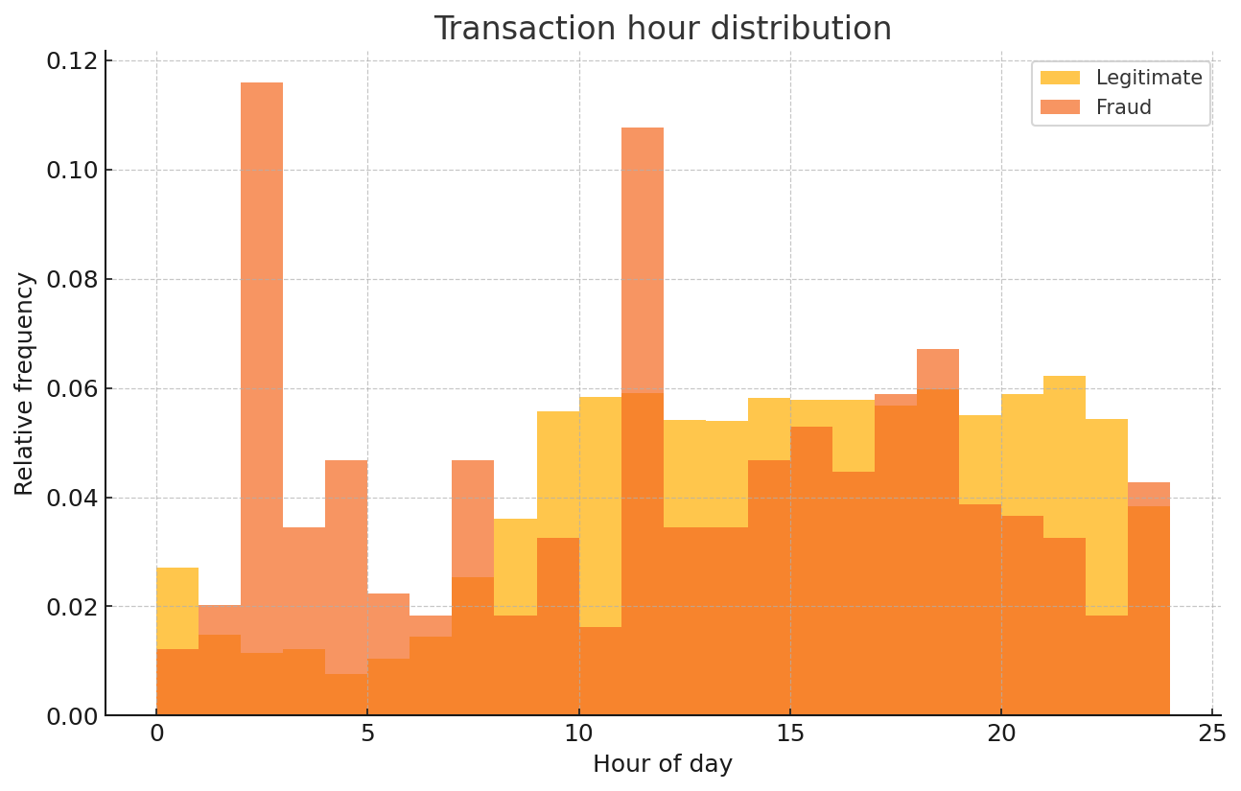
When Do Frauds Happen?
Fraud spikes between 1 AM – 5 AM (probably because people are asleep)
Notes:
fraud peaks 1 am–5 am when users sleep and staffing is minimal
supports automated overnight screening
suggests targeted manual-review staffing during peak hours

Slide 7
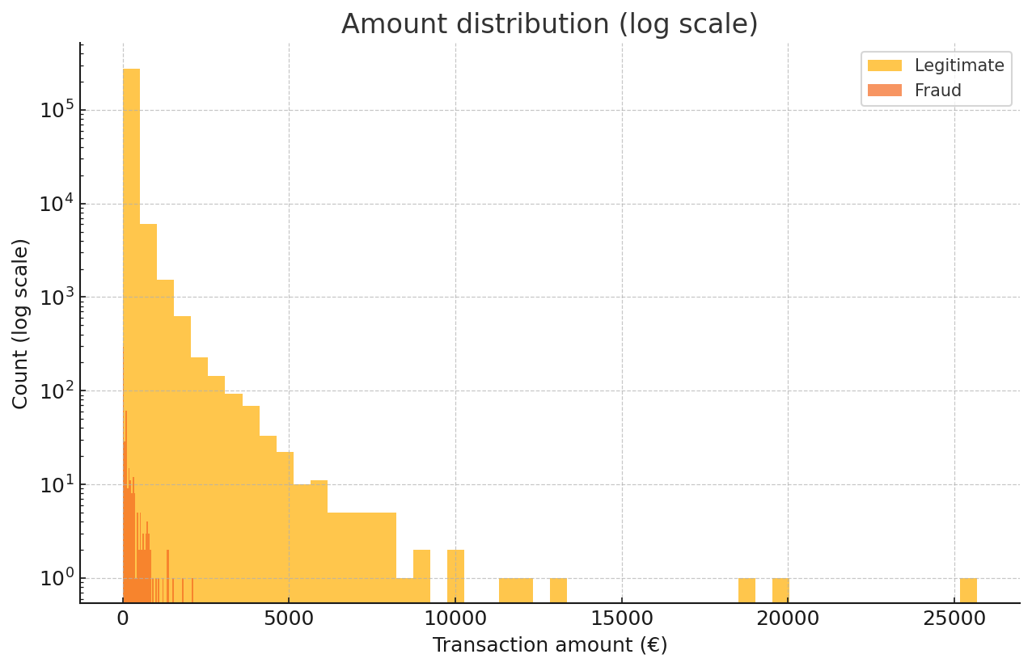
How Much Is Stolen?
Frauds cluster at lower amounts to avoid suspicion
Notes:
fraudulent amounts cluster under €150 to evade rules
individually small, but collectively significant leakage
early detection yields strong ROI

Slide 8
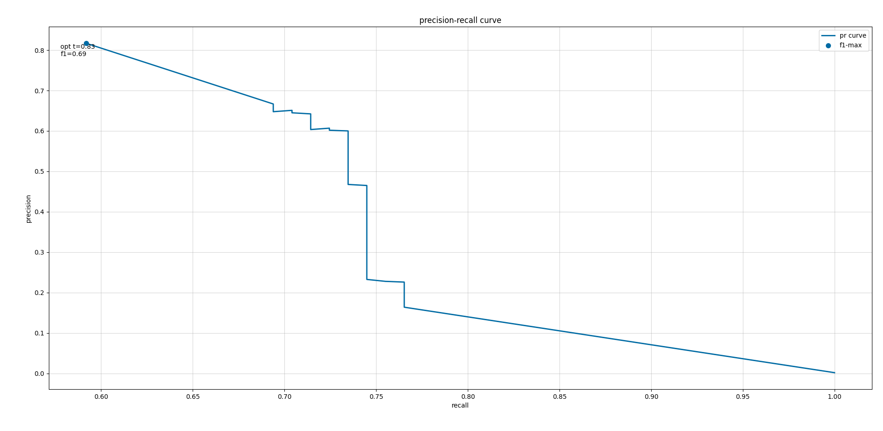
Precision–Recall Curve (Test Set)
Optimal F1 at threshold 0.83 (precision 0.81, recall 0.59)
Notes:
precision: “what fraction of flagged are real fraud?”
recall: “what fraction of fraud did we catch?”
optimal F1 at probability threshold 0.83 → 81 % precision, 59 % recall
threshold within current analyst capacity

Slide 9

Decision Threshold
and Confusion Matrix
Threshold 0.83 yields:
True Positives: 291
False Positives: 68
False Negatives: 202
True Negatives: 56 601
≈ 80 % of flagged cases are genuine frauds
This is…acceptable
Notes:
confusion matrix: 291 true positives, 68 false positives
roughly 4 out of 5 alerts are genuine
202 frauds missed; threshold could be lowered if more reviewers or automation

Slide 10
Business Impact Model
Avg fraud amount:
€105 → blocking 291 TP saves ≈ €30 k / test‑day snapshot
Cost per manual review:
€2 × 359 daily investigations → €718
Net daily benefit ≈ €29.3 k (this is also increasing with automation)
Customer trust increases while regulatory compliance risk decreases
Notes:
avg. fraud amount €105 → blocking 291 saves ~€30 k/day
manual reviews cost €2 each → 359 reviews cost €718
net daily benefit ~€29.3 k + improved trust and compliance
No icon because this is serious :nodders:

Slide 11

Accessibility and Design Choices
Colour‑blind‑safe Tableau palette
Should have a ≥ 4.5 : 1 contrast ratio
18 pt fonts for legibility on 1024x768 projectors
Annotations should replace legends on plots
Interactive dashboard!
Notes:
WCAG-compliant, color-blind-safe palettes
≥ 4.5:1 contrast ratio
fonts ≥ 18 pt for projector legibility
annotations replace legends to minimize eye travel
interactive dashboards for drill-down

Slide 12

Future Work & Roadmap
Cost‑sensitive learning (penalise FP 3× TP)
Explainability: SHAP waterfall for individual alerts
Real‑time A/B test of threshold slider
Deploy model via AWS Lambda – < 50 ms latency benchmark
Notes:
cost-sensitive learning (penalize false positives ×3)
SHAP-based explainability for analyst trust
live A/B test with adjustable threshold slider
serverless deployment (AWS Lambda) for sub-50 ms latency

Slide 13
Questions?

Slide 14
References
European Credit Card Dataset (2013), UCI ML Repository
Ke et al., LightGBM: A Highly Efficient Gradient Boosting Decision Tree. NIPS 2017
WCAG 2.1 Accessibility Guidelines

